Slide 1
EcoBot: The Smart Garbage Collection Robot
Muhammad yasser alali
200047921
Dr. Mohammed Marei Eng. Ahmed Abdellatif

Slide 2
Introduction & Objective
What is the project?
"EcoBot" is a prototype of a wireless-controlled mobile robot, equipped with a 4-Axis Robotic Arm.
How does it work?
The robot is fully controlled (for both movement and the arm) using PS5 controller via Bluetooth.
The Goal?
The objective is to provide a technical solution to help preserve the environment by designing an automated (smart) system capable of collecting waste and garbage from public spaces.

Slide 3
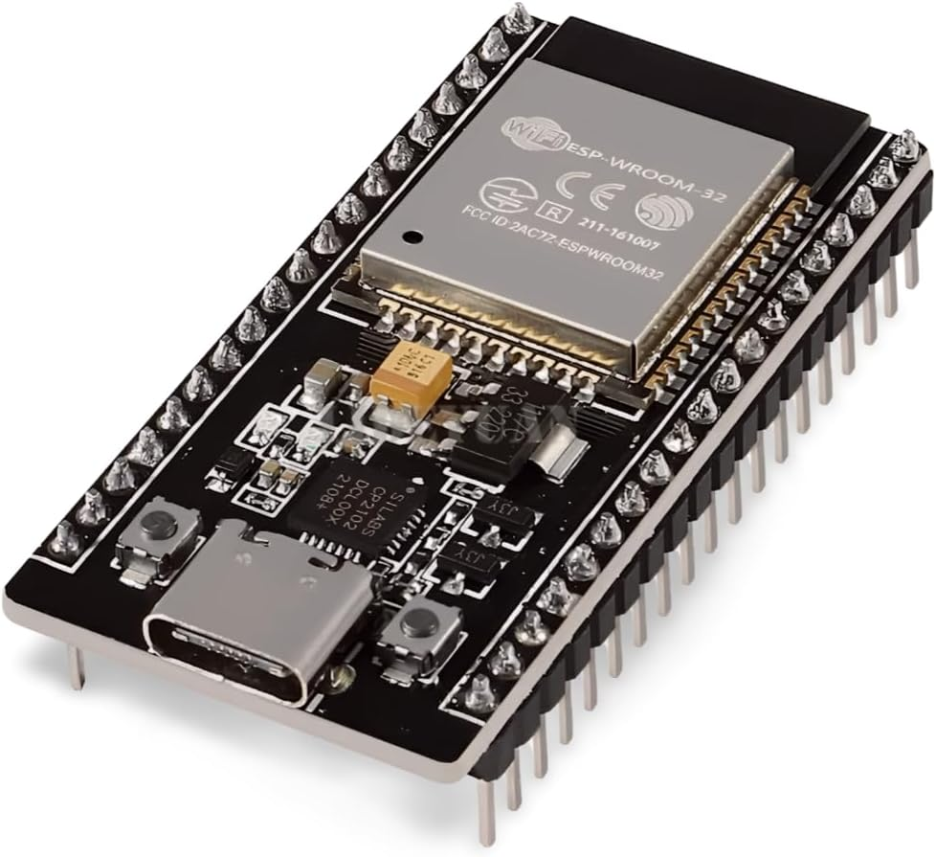
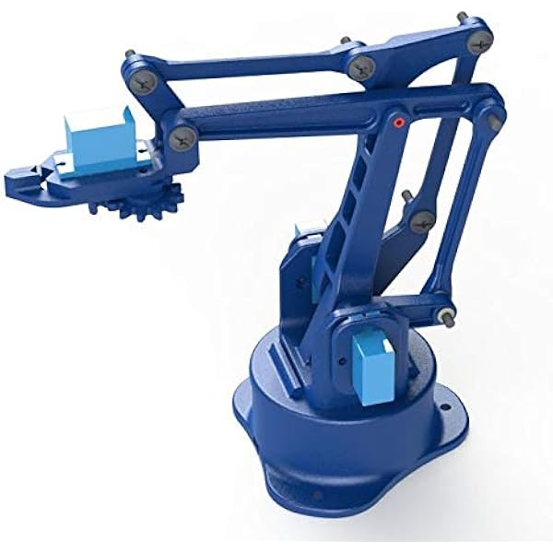
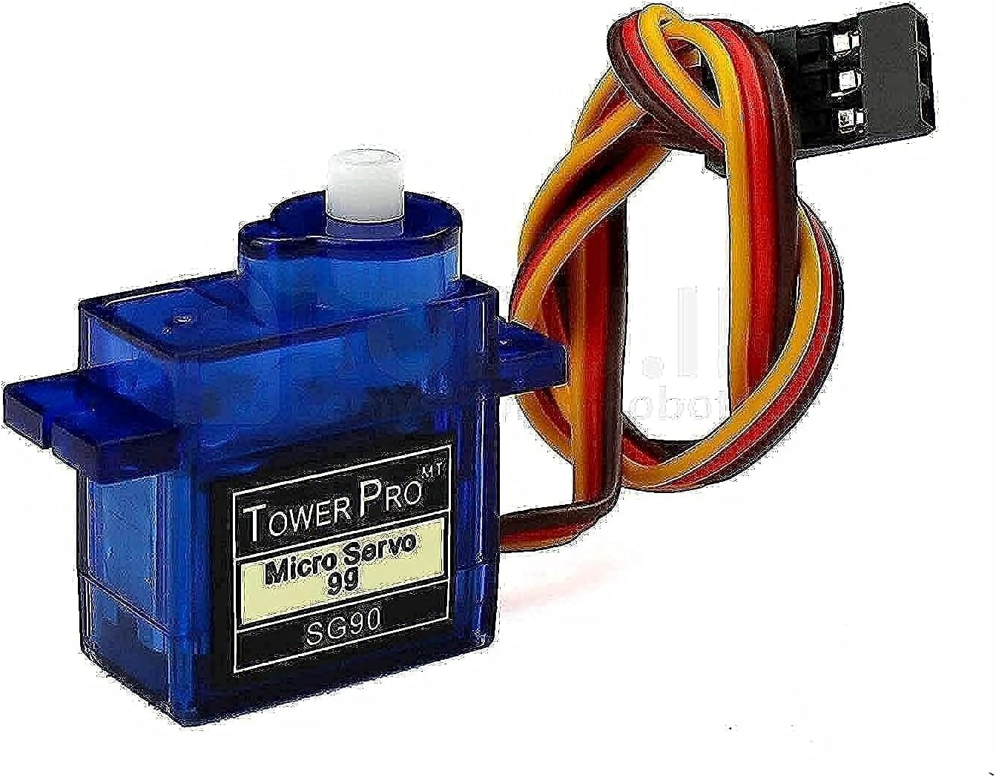
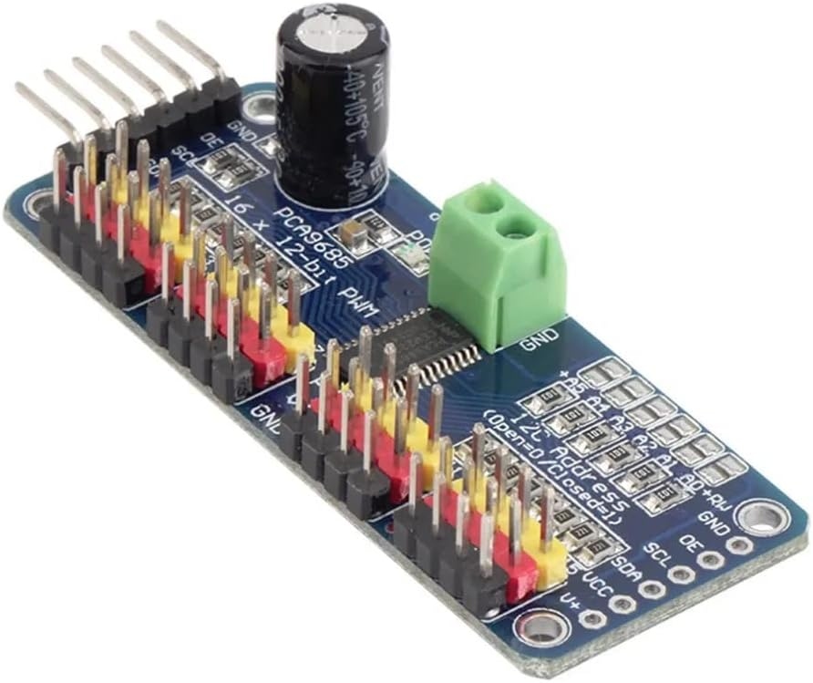
Hardware Components:
Main Controller:
Robotic Arm:
ESP32 Board (for Bluetooth and logic control).
Robot arm
4 Servo Motors (Base, Shoulder, Elbow, Gripper)
PCA9685 16-Channel Servo Driver (for precise control via I2C).

Slide 4
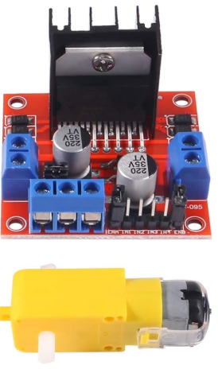
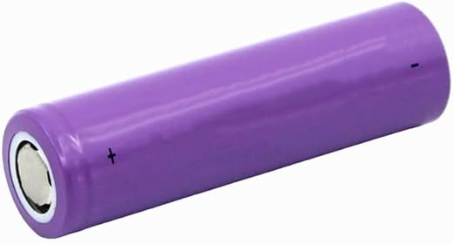
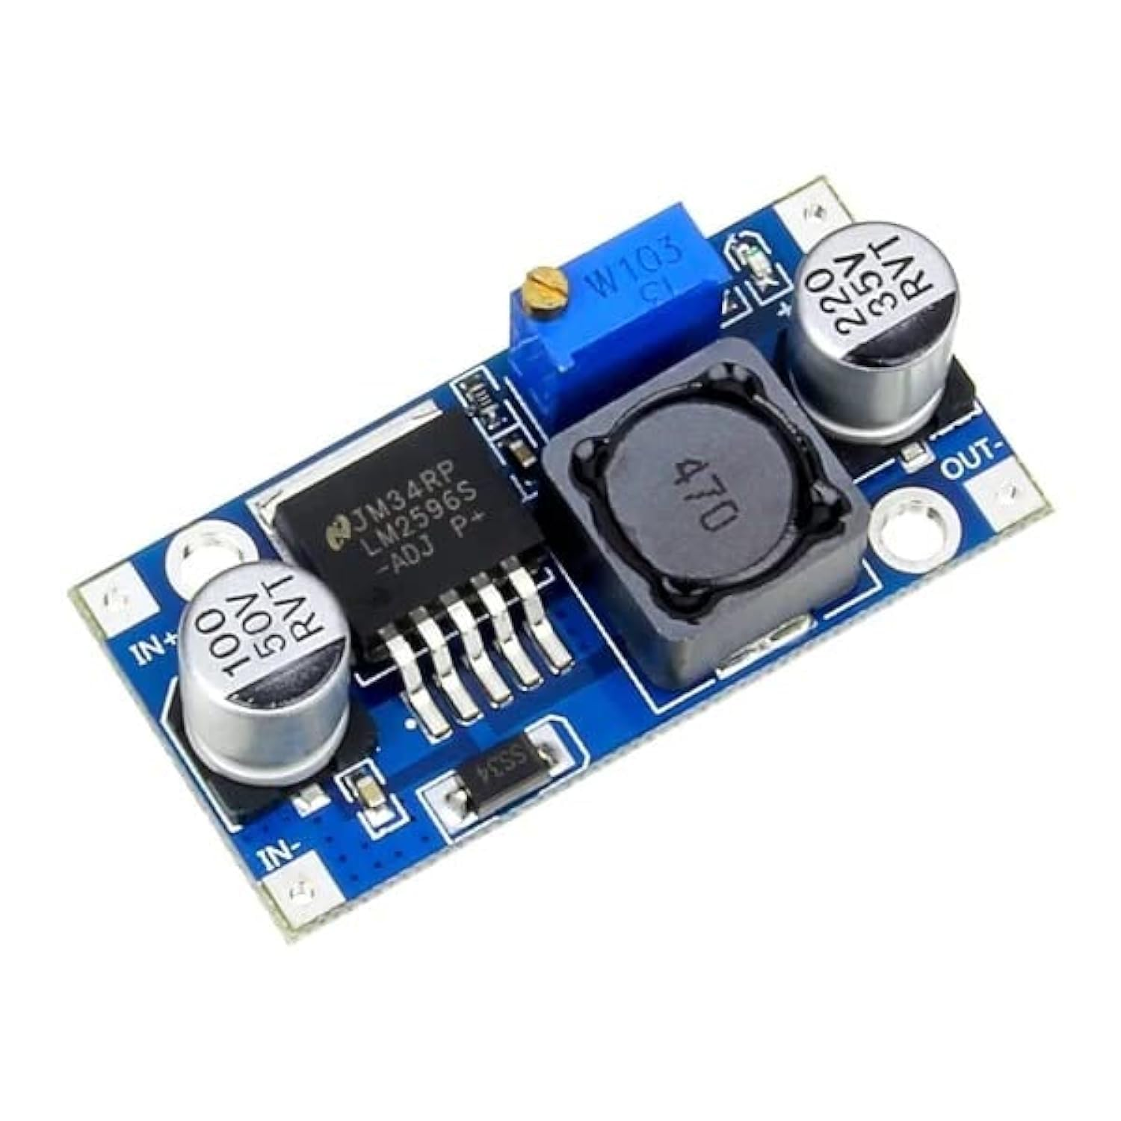
Hardware Components:
Power System:
Drive System:
4 DC Motors (wired as pairs).
L298N Motor Driver.
Main Battery (11V LiPo): Powers the Motors (L298N) and the ESP32.
Secondary Battery (7.4V): Powers the Servo Driver (PCA9685) only.
Buck Converter: Steps down the main 7.4V to a clean 5V for the ESP32 and L298N logic.

Slide 5
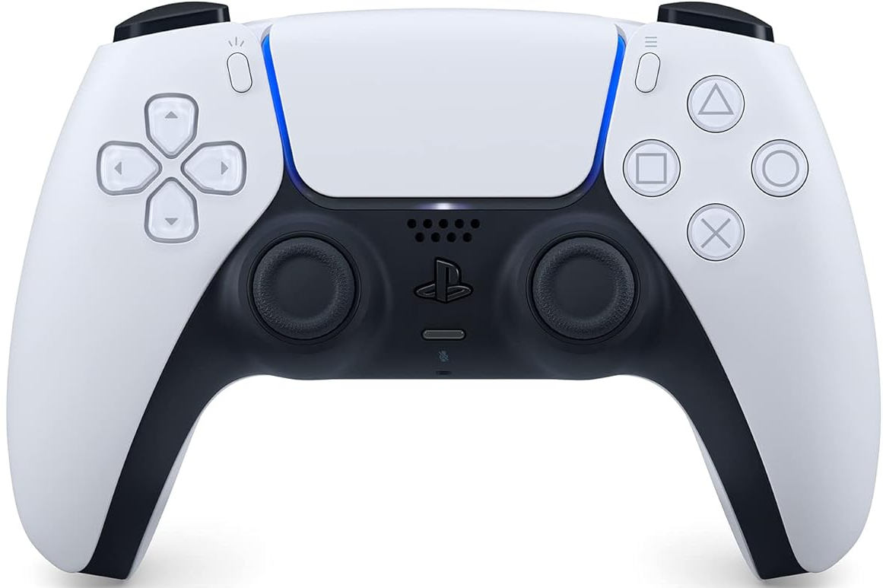
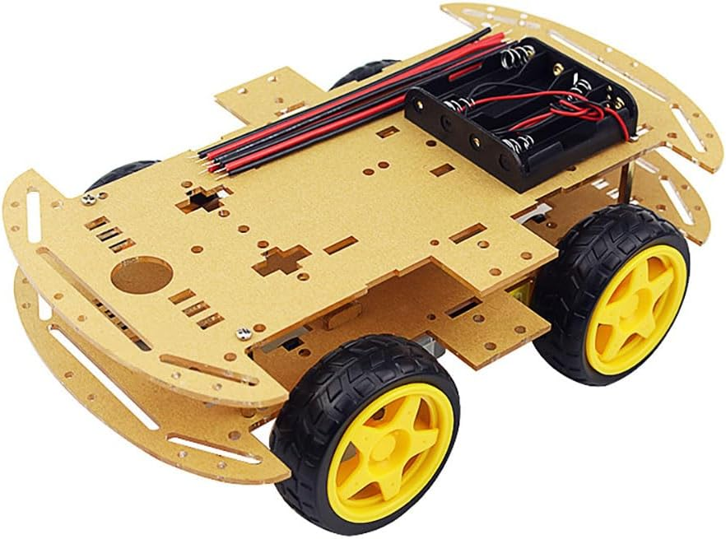
Hardware Components:
Control System:
Chassis:
PS5 Controller: Just for operating experience
Custom-built wooden chassis.

Slide 6
System Architecture:
Power Distribution:
11V Battery → Feeds the L298N (VMS) and the Buck Converter (IN).
7.4V Battery → Feeds the PCA9685 (V+) (Servo power).
Buck Converter (5V OUT) → Feeds the ESP32 (5V), the L298N (5V Logic), and the PCA9685 (5V) (Logic power).
Common Ground (GND):
All GNDs (Both Batteries, Buck, ESP32, L298N, PCA9685) must be connected together.
Control Signals (ESP32):
L298N (Left): GPIO 16, 17, 18 .
L298N (Right): GPIO 5, 13, 14 .
PCA9685 (I2C): GPIO 4 (SDA), 15 (SCL).

Slide 7
Software & Technologies
IDE: Arduino IDE (C++).
Board Package:
esp32_bluepad32 (Required for stable PS5 controller support).
Wireless Control:
Bluepad32 Library (Connects to PS5 and handles virtual devices).
Motor Control (L298N):
ledcSetup/ledcAttachPin for precise PWM speed control (at 5KHz).
Arm Control (PCA9685):
Wire.h (I2C Protocol).
Adafruit_PWMServoDriver Library (Manages all 16 servo channels).
Code Logic:
An adaptive vTaskDelay(active ? 1 : 5) logic to balance responsiveness and system stability.

Slide 8
Control Logic:
Vehicle Movement:
Forward (Variable Speed): Left Joystick (Up)
Backward (Variable Speed): Left Joystick (Down)
Spin Left (Fixed Speed): Triangle Button (△)
Spin Right (Fixed Speed): Circle Button (○)
Robotic Arm:
Base (Left/Right): L2 / R2
Shoulder (Up/Down): Right Joystick (Up/Down)
Elbow (Forward/Back): L1 / R1
Gripper : Open ( □ ) / Close ( X )

Slide 9
Code Structure Summary
Core Functions:
setup() – Initializes hardware (motors, servos, Bluetooth).
loop() – Runs continuously, handles input and logic.
Main Logic Function:
control(ControllerPtr ctl) – Reads controller input and calls helper functions.
Helper Functions:
motor(left, dir, spd) – Controls robot motors (L298N).
servo(ch, ang) – Controls a servo via PCA9685.
Bluetooth Callbacks:
onConnect(ctl) – Triggered when a controller connects.
onDisconnect(ctl) – Triggered when a controller disconnects.

Slide 10
Challenges Faced
1. Initial Hardware Failure:
We faced the failure of two ESP32 boards at the start of the project due to incorrect power wiring and attempts to use an L293D shield.
2. L293D Driver Incompatibility:
We discovered the L293D shield was defective (M1/M2 channels were dead) and used a complex (Shift Register) control system.
Solution: Replaced it with the simpler and more robust L298N driver.
3. Bluetooth Connectivity Issues:
Difficulty connecting Bluepad32 due to experimenting with other (incompatible) Bluetooth libraries, which led to a Core Software Conflict in the Arduino IDE.
Solution: The solution was to switch libraries.

Slide 11
Results & Demo
Current Status:
A fully functional prototype.
The robot connects reliably to the PS5 controller.
All systems (Movement and Arm) respond correctly to the new control scheme.
The "dual-voltage" power system successfully isolates motor noise from the logic circuits.
Live Demonstration:
(Click to watch the video)

Slide 12
Future Operations:
1. Standalone Mode (AI):
Integration of an ESP32-CAM vision camera.
AI/Machine Learning training model (using tools such as Edge Impulse) on:
Object Detection (detecting objects).
Waste Sorting (distinguishing between plastic, paper, and metal).
2. Mechanical Improvements: (Corrected from "Pricing")
Design and printing of a custom, lightweight frame and use of high-quality components.

Slide 13
Thank you for your attention

